Slide 1
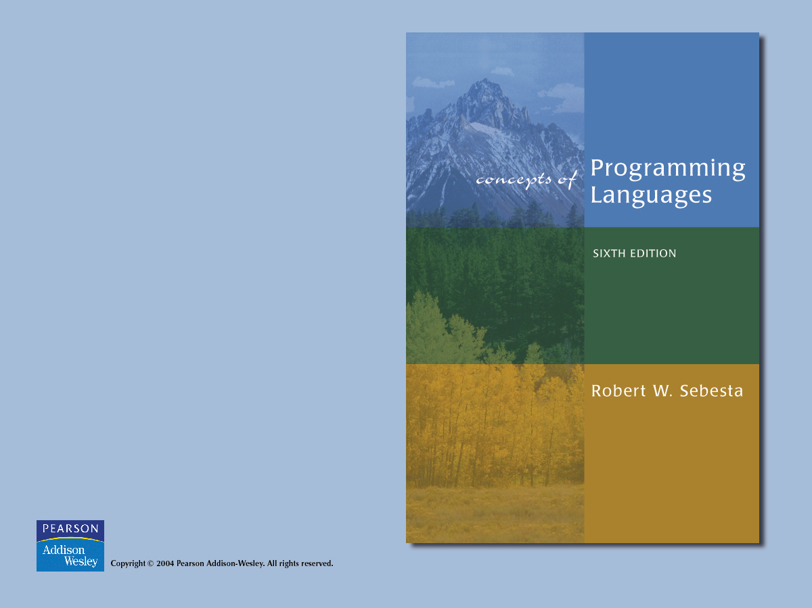
Chapter 7
Expressions and
Assignment Statements

Slide 2

Chapter 7 Topics
Introduction
Arithmetic Expressions
Overloaded Operators
Type Conversions
Relational and Boolean Expressions
Short-Circuit Evaluation
Assignment Statements
Mixed-Mode Assignment

Slide 3
Introduction
Expressions are the fundamental means of specifying computations in a programming language
To understand expression evaluation, need to be familiar with the orders of operator and operand evaluation
Essence of imperative languages is dominant role of assignment statements

Slide 4
Arithmetic Expressions
Their evaluation was one of the motivations for the development of the first programming languages
Arithmetic expressions consist of operators, operands, parentheses, and function calls

Slide 5
Arithmetic Expressions
Design issues for arithmetic expressions:
  1. What are the operator precedence rules?
  2. What are the operator associativity rules?
  3. What is the order of operand evaluation?
  4. Are there restrictions on operand evaluation side effects?
  5. Does the language allow user-defined operator overloading?
  6. What mode mixing is allowed in expressions?

Slide 6
Arithmetic Expressions
A unary operator has one operand
A binary operator has two operands
A ternary operator has three operands

Slide 7
Arithmetic Expressions
Def: The operator precedence rules for expression evaluation define the order in which “adjacent” operators of different precedence levels are evaluated (“adjacent” means they are separated by at most one operand)
Typical precedence levels
  1. parentheses
  2. unary operators
  3. ** (if the language supports it)
  4. *, /
  5. +, -

Slide 8
Arithmetic Expressions
Def: The operator associativity rules for expression evaluation define the order in which adjacent operators with the same precedence level are evaluated
Typical associativity rules:
  Left to right, except **, which is right to left
  Sometimes unary operators associate right to left (e.g., FORTRAN)
APL is different; all operators have equal precedence and all operators associate right to left
Precedence and associativity rules can be overriden with parentheses

Slide 9
Arithmetic Expressions
Operand evaluation order
  The process:
  1. Variables: just fetch the value
  2. Constants: sometimes a fetch from memory; sometimes the constant is in the machine language instruction
  3. Parenthesized expressions: evaluate all operands and operators first
  4. Function references: The case of most interest
    Order of evaluation is crucial

Slide 10
Arithmetic Expressions
Functional side effects - when a function changes a two-way parameter or a nonlocal variable
The problem with functional side effects:
  When a function referenced in an expression alters another operand of the expression; e.g., for a parameter change:
a = 10;
b = a + fun(&a);
/* Assume that fun changes its parameter */
  Same problem with global variables

Slide 11
Functional Side Effects
Two Possible Solutions to the Problem:
  1. Write the language definition to disallow functional side effects
  No two-way parameters in functions
  No nonlocal references in functions
  Advantage: it works!
  Disadvantage: Programmers want the flexibility of two-way parameters (what about C?) and nonlocal references

Slide 12
Functional Side Effects
Two Possible Solutions to the Problem (continued):
  2. Write the language definition to demand that operand evaluation order be fixed
  Disadvantage: limits some compiler optimizations

Slide 13
Arithmetic Expressions
Conditional Expressions
  C, C++, and Java (?:)
  e.g.
average = (count == 0)? 0 : sum / count

Slide 14
Overloaded Operators
Def: use of an operator for more than one purpose is called operator overloading
Some are common (e.g., + for int and float)
Some are potential trouble (e.g., * in C and C++)
  Loss of compiler error detection (omission of an operand should be a detectable error)
  Some loss of readability
  Can be avoided by introduction of new symbols (e.g., Pascal’s div)

Slide 15
Overloaded Operators
C++ and Ada allow user-defined overloaded operators
Potential problems:
  Users can define nonsense operations
  Readability may suffer, even when the operators make sense

Slide 16
Type Conversions
Def: A narrowing conversion is one that converts an object to a type that cannot include all of the values of the original type e.g., float to int
Def: A widening conversion is one in which an object is converted to a type that can include at least approximations to all of the values of the original type e.g., int to float

Slide 17
Type Conversions
Def: A mixed-mode expression is one that has operands of different types
Def: A coercion is an implicit type conversion
The disadvantage of coercions:
  They decrease in the type error detection ability of the compiler
In most languages, all numeric types are coerced in expressions, using widening conversions
In Ada, there are virtually no coercions in expressions

Slide 18
Type Conversions
Explicit Type Conversions
Often called casts
e.g.
Ada:
FLOAT(INDEX)--INDEX is INTEGER type
Java:
(int)speed /*speed is float type*/

Slide 19
Type Conversions
Errors in Expressions
Caused by:
  Inherent limitations of arithmetic e.g. division by zero
  Limitations of computer arithmetic e.g. overflow
Such errors are often ignored by the run-time system

Slide 20
Relational and Boolean Expressions
Relational Expressions:
  Use relational operators and operands of various types
  Evaluate to some Boolean representation
  Operator symbols used vary somewhat among languages (!=, /=, .NE., <>, #)

Slide 21
Relational and Boolean Expressions
Boolean Expressions
  Operands are Boolean and the result is Boolean
  Operators:
FORTRAN 77 FORTRAN 90 C Ada
  .AND. and && and
  .OR. or || or
  .NOT. not ! not
  xor

Slide 22
Relational and Boolean Expressions
C has no Boolean type--it uses int type with 0 for false and nonzero for true
One odd characteristic of C’s expressions: a < b < c is a legal expression, but the result is not what you might expect

Slide 23
Relational and Boolean Expressions
Precedence of all Ada operators:
  **, abs, not
  *, /, mod, rem
  unary -, +
  binary +, -, &
  relops, in, not in
  and, or, xor, and then, or else
C, C++, and Java have over 40 operators and at least 15 different levels of precedence

Slide 24
Short Circuit Evaluation
Suppose Java did not use short-circuit evaluation
Problem: table look-up
index = 1;
while (index <= length) && (LIST[index] != value)
index++;

Slide 25
Short Circuit Evaluation
C, C++, and Java: use short-circuit evaluation for the usual Boolean operators (&& and ||), but also provide bitwise Boolean operators that are not short circuit (& and |)
Ada: programmer can specify either (short-circuit is specified with and then and or else)
FORTRAN 77: short circuit, but any side-affected place must be set to undefined
Short-circuit evaluation exposes the potential problem of side effects in expressions
e.g. (a > b) || (b++ / 3)

Slide 26
Assignment Statements
The operator symbol:
  1. = FORTRAN, BASIC, PL/I, C, C++, Java
  2. := ALGOLs, Pascal, Ada
= Can be bad if it is overloaded for the relational operator for equality e.g. (PL/I) A = B = C;
Note difference from C

Slide 27
Assignment Statements
More complicated assignments:
  1. Multiple targets (PL/I)
  A, B = 10
  2. Conditional targets (C, C++, and Java)
  (first==true)? total : subtotal = 0
  3. Compound assignment operators (C, C++, and Java)
  sum += next;

Slide 28
Assignment Statements
More complicated assignments (continued):
  4. Unary assignment operators (C, C++, and Java)
  a++;
  C, C++, and Java treat = as an arithmetic binary operator
  e.g.
  a = b * (c = d * 2 + 1) + 1
  This is inherited from ALGOL 68

Slide 29
Assignment Statements
Assignment as an Expression
  In C, C++, and Java, the assignment statement produces a result
  So, they can be used as operands in expressions
  e.g.
while ((ch = getchar())!=EOF){…}
  Disadvantage
    Another kind of expression side effect

Slide 30
Mixed-Mode Assignment
In FORTRAN, C, and C++, any numeric value can be assigned to any numeric scalar variable; whatever conversion is necessary is done
In Pascal, integers can be assigned to reals, but reals cannot be assigned to integers (the programmer must specify whether the conversion from real to integer is truncated or rounded)
In Java, only widening assignment coercions are done
In Ada, there is no assignment coercion

